Slide 1
Construction Inspection Jeopardy
Also known as contractor failures

Slide 2
Roadway Pumping
Son of a Ditch
Twisted Guardrail
Bridge to Nowhere
$100
$100
$100
$100
$200
$200
$200
$200
$300
$300
$300
$300
$400
$400
$400
$400
$500
$500
$500
$500

Slide 3
The contractor shall remove all these from the slopes and fill areas
Answer

Slide 4
Rocks greater than 4 inches
208.03.02 Preparation of Existing Roadway. Before proceeding with other construction operations, grade and shape the roadway to 0.1 foot below the grades, lines, and cross-section required for the completed roadway. Remove any organic material, such as roots, and any rocks larger than 4 inches from the material to be stabilized.

Slide 5
The contractor shall clean up all “”
Answer

Slide 6
Construction Debris
Asphalt
Concrete
Trash
Traffic Control Devices
Etc…

Slide 7
The contractor shall get a small dozer to “________” the slopes where fill material has “_____”
Answer

Slide 8
Re-dress and re-seed washed areas in the slopes

Slide 9
The contractor shall add material to the shoulder to ….
Answer

Slide 10
What is to create the shoulder slope as per the cross sections?

Slide 11
The contractor shall apply as directed by 212.03.03 D)
Answer

Slide 12
Maintenance Fertilizer

Slide 13
The contractor shall grout all “”
Answer

Slide 14
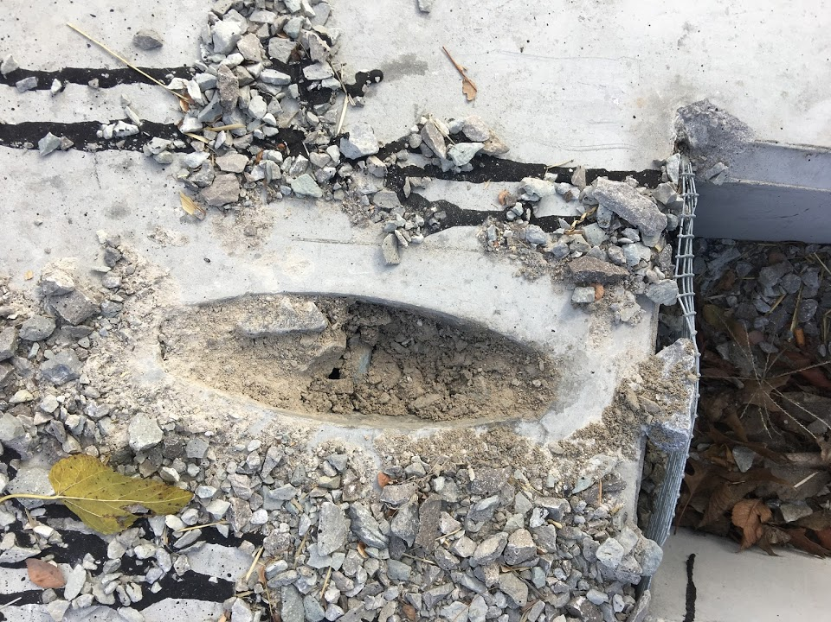
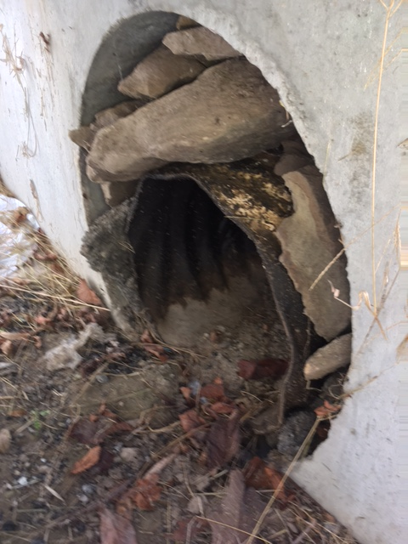
Lift holes and pipe connection points in all drainage structures

Slide 15
The contractor shall chain all “___” to drainage structure to prevent theft.
Answer

Slide 16
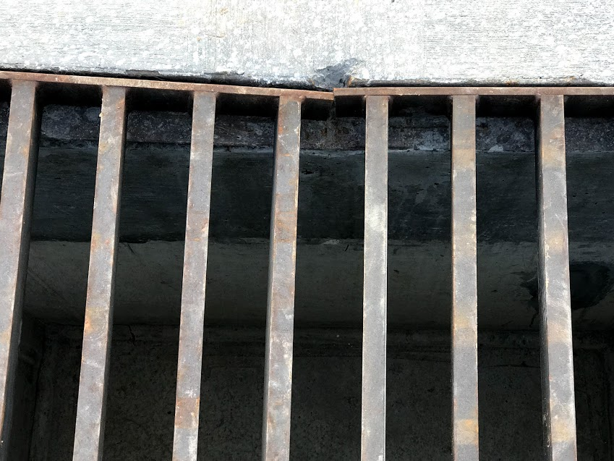
Grates

Slide 17
The contractor shall install “_____” in all ditches as per 212.03.03 E)
Answer

Slide 18
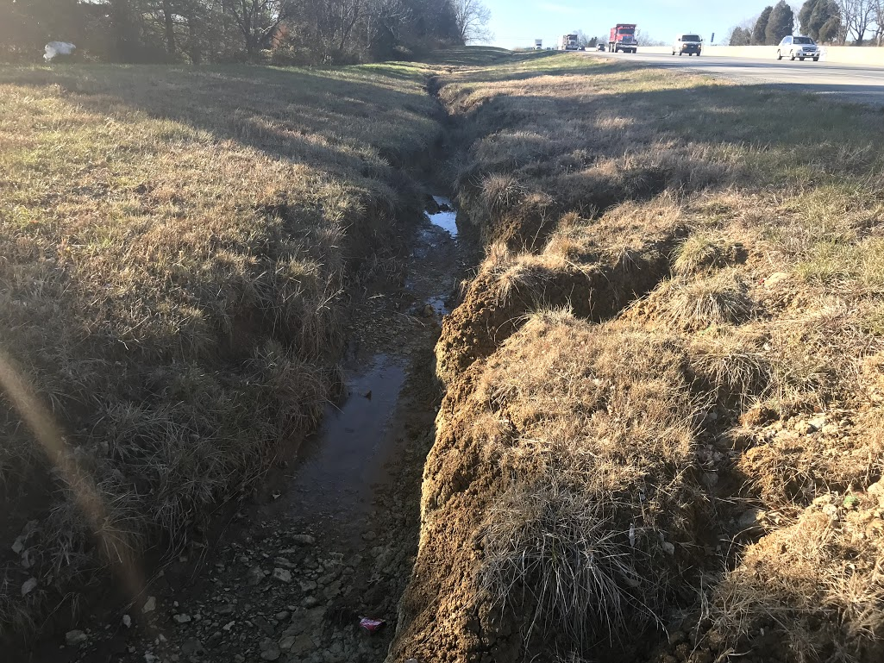
Paved, rock lined or erosion control blanket

Slide 19
The contractor shall correct all channel lining that is “____”
Answer

Slide 20
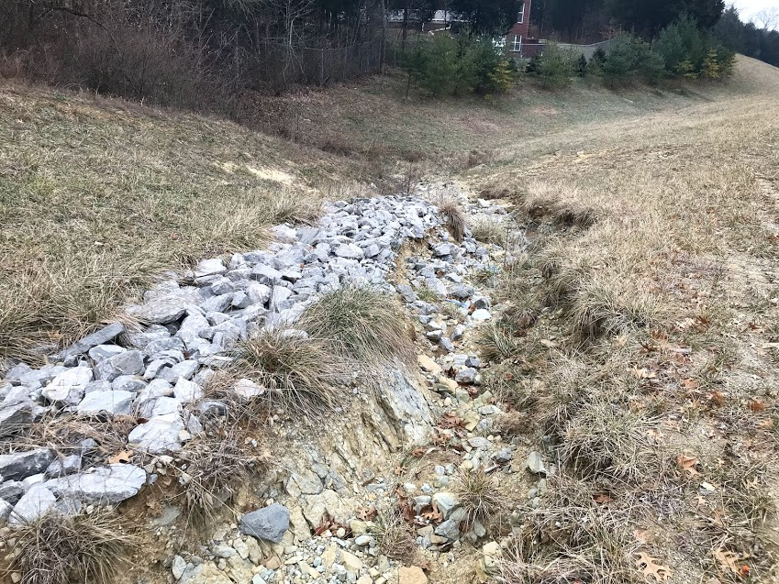
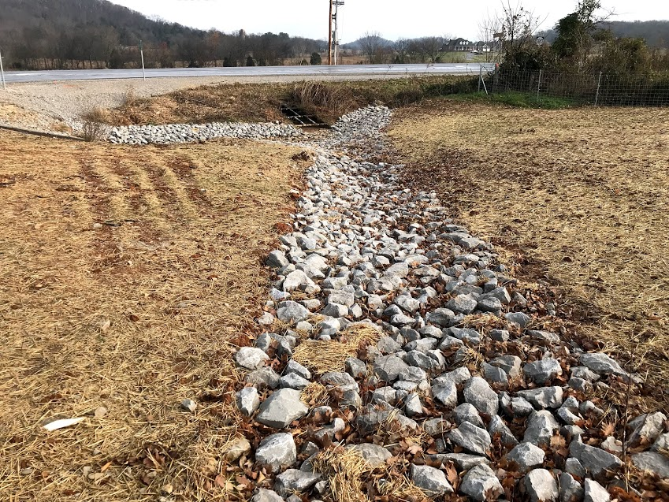
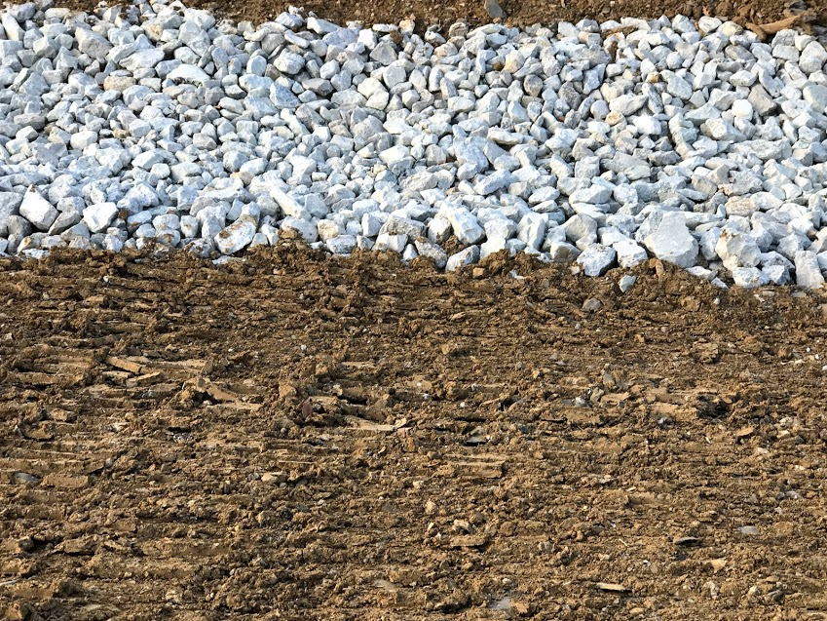
Channel Lining that is higher than the surrounding slopes

Slide 21
During the final inspection ponding water was found in several ditches.
Answer

Slide 22
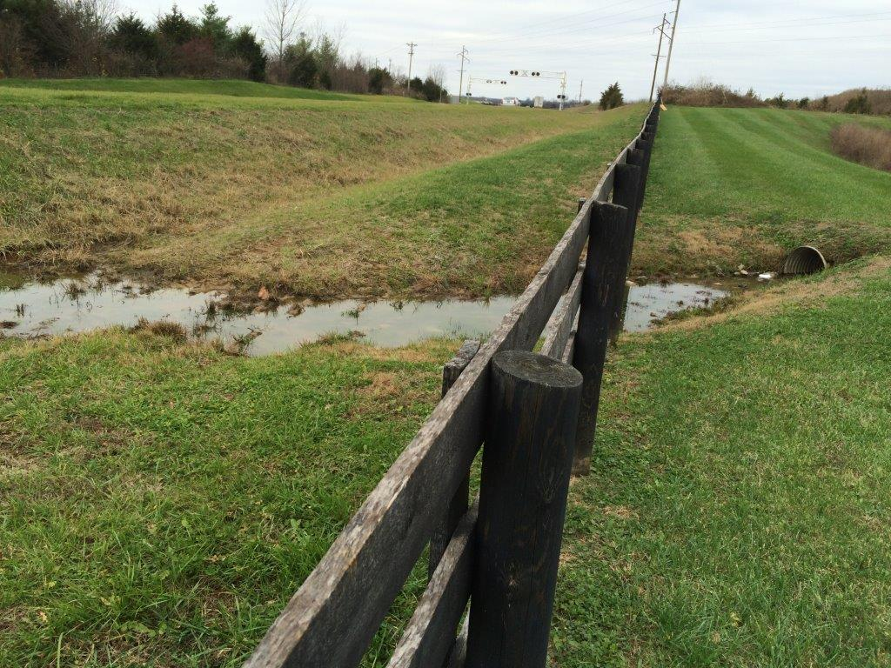
What is grade the ditch to drain?

Slide 23
The contractor shall install this 6” below ground line?
Answer

Slide 24
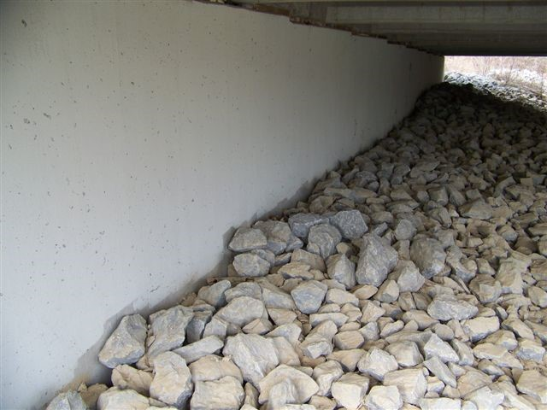
Masonry Coating

Slide 25
The contractor shall grind/patch all concrete surfaces as per 601.03.18 A)
Answer

Slide 26
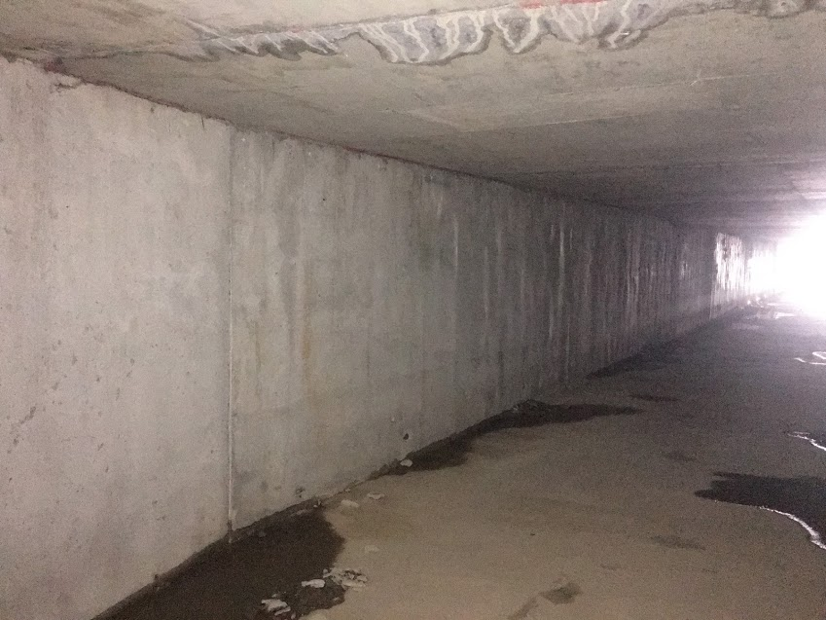
What is Ordinary Surface Finish

Slide 27
The contractor shall remove all “______”
Answer

Slide 28
What is form material and scrap pieces of reinforcing steel

Slide 29
The contractor shall propose a corrective method to seal all “______”.
Answer

Slide 30
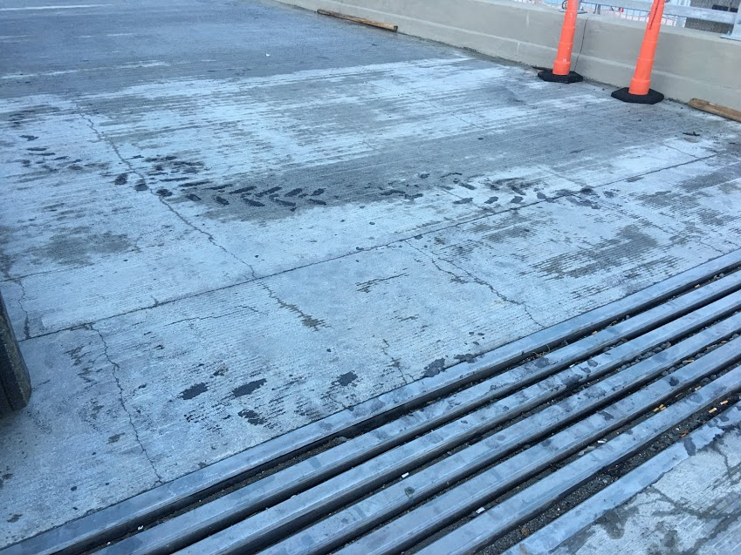
What are cracks

Slide 31
The contractor shall install “_____” between the curb and barrier wall of bridge as per 601.03.16.
Answer

Slide 32
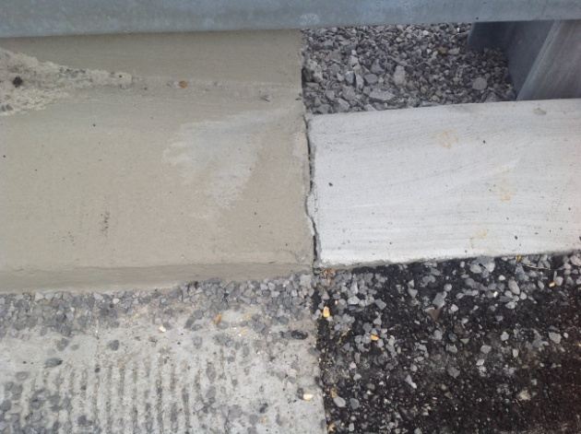
What is expansion material

Slide 33
The contractor shall tighten “_____” as per the manufacturer installation instructions
Answer

Slide 34
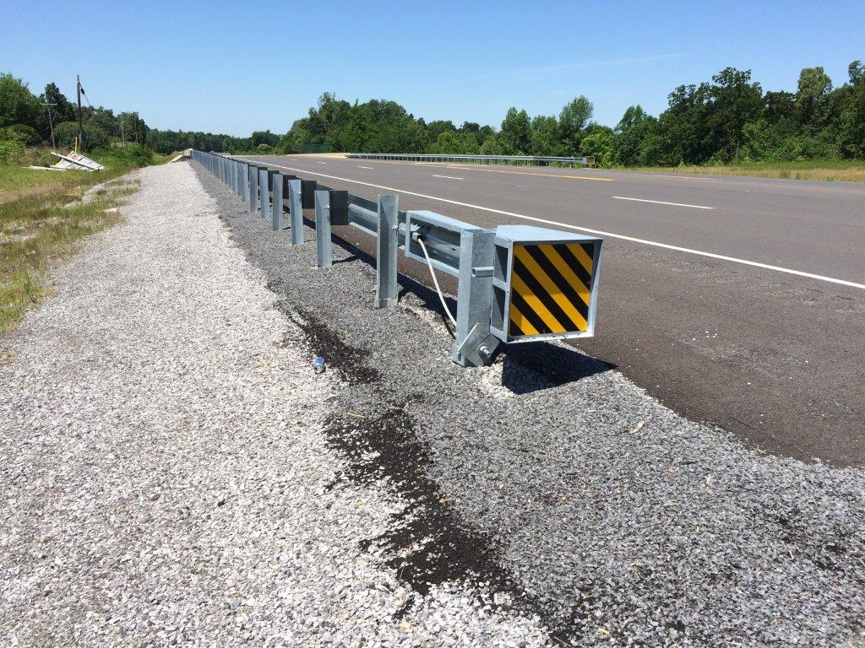
Cable Assembly

Slide 35
The contractor shall install “____” to prevent the bearing plate from rotating.
Answer

Slide 36
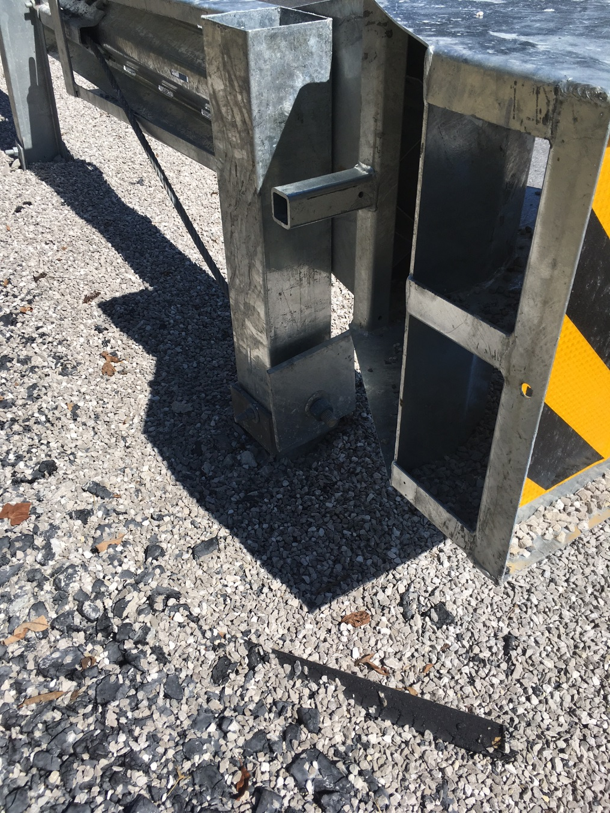
Zip-tie

Slide 37
The contractor shall fill in around all “________”
Answer

Slide 38
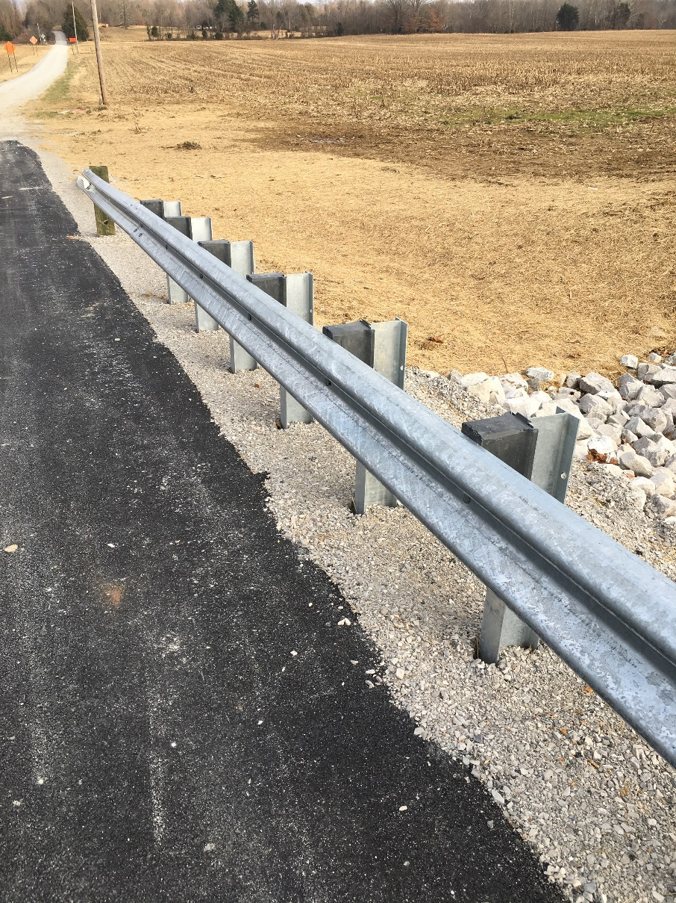
Guardrail post

Slide 39
The contractor shall grade around end treatment so that “_____”
Answer

Slide 40
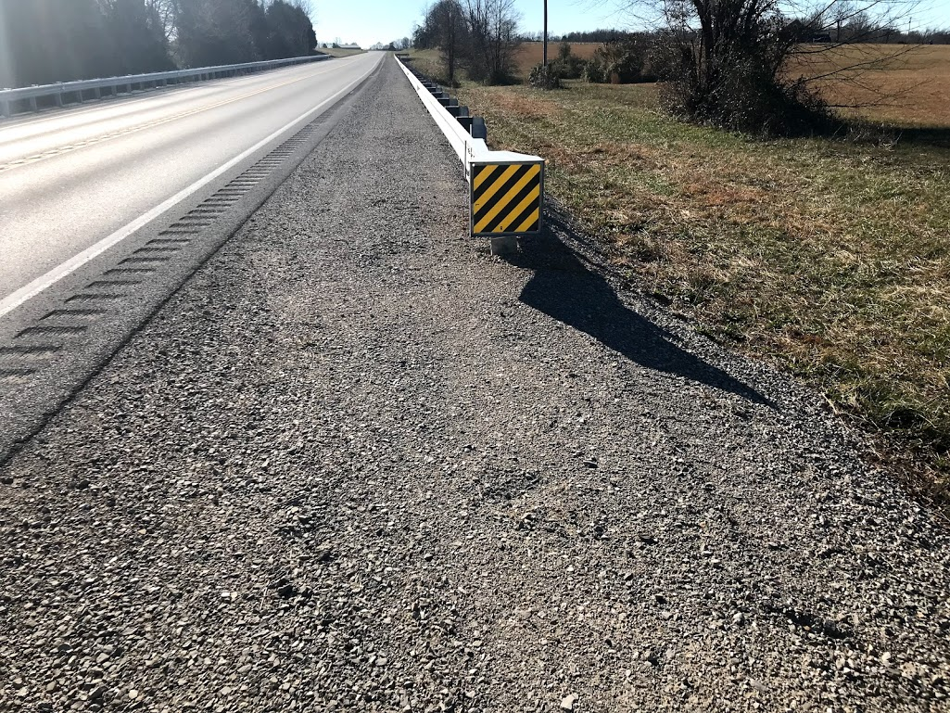
The strut is flush with DGA and grading around end treatment is in compliance with applicable standard

Slide 41
The contractor shall install “____” below the Bridge Connector Type A as per STD Drawing RBC 005
Answer

Slide 42
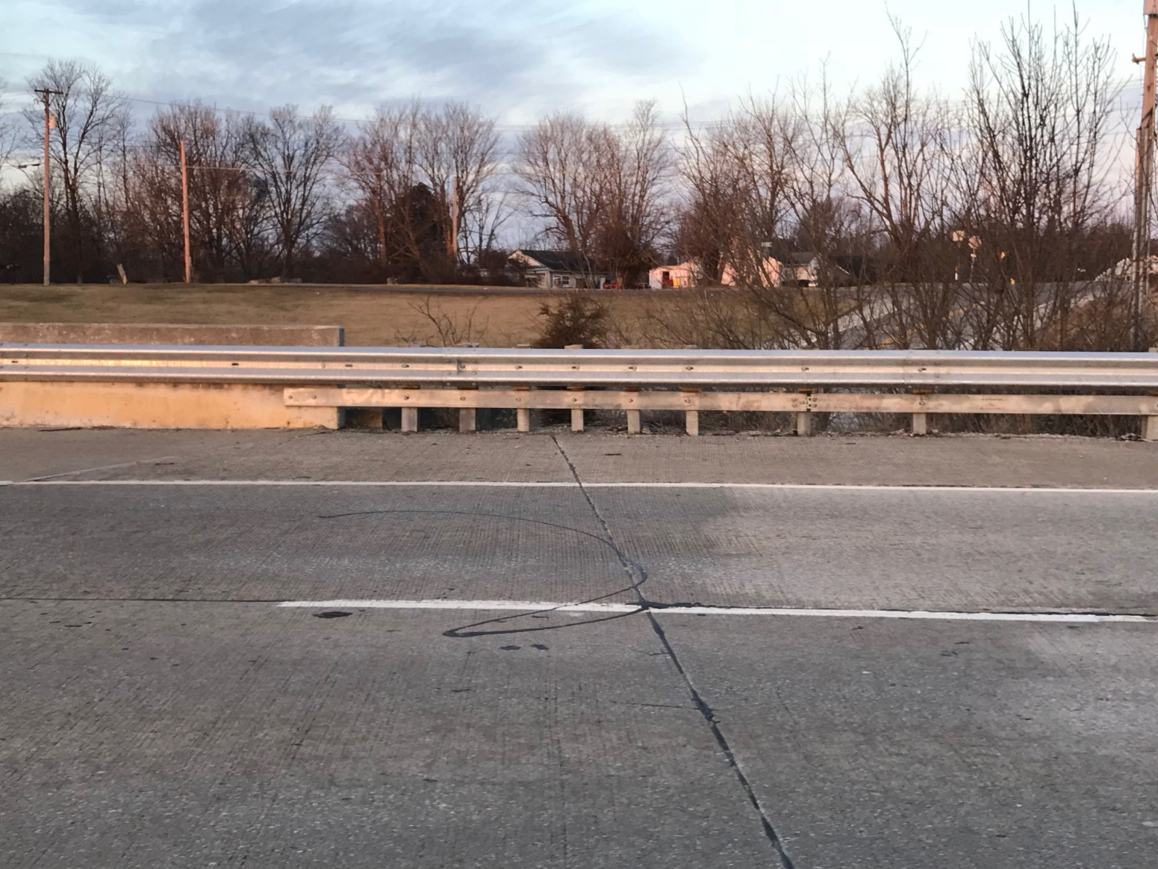
Island Header Curb

